Slide 1
House Price
Demand
Wage
Trends
Supply
Cost to build
Permission to build
Inflation
Demographic
Federal Spending
State of Economy
Innovation
Situation
Advancement
Weather
Labor
Land Availability
Government Laws
Technological
Piping & Material
Favorable
Unfavorable
Wage
Number

Slide 2
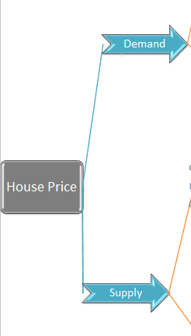
Factors that could influence residential home prices across the United States over the next decade
Contents
Housing prices
Supply
Demand
Supply vs Demand
The Beast in the room: Housing prices
Coming back to the tree diagram shown above, it's huge and unreadable. Let's explain the monster going through it level by level, and hope our clients get enough understanding to navigate the seas with it.
Yes, that's right! supply and demand. These are the root cause on which the housing prices depend.

Slide 3
Supply
The supply of the houses depends upon two factors, “permission to build” and “time and cost to build,” which can be broken down further into many other factors. And finally, the leaf nodes are the hypotheses that either support the supply or are against the supply. The leaf nodes with a green border will help increase the supply, while the red ones will decrease the supply.
Demand
The demand for houses depends upon wage and Trends, which can be broken down into smaller factors. As you can see, all the leaf nodes have a green border, which means all the hypotheses support the increase in house demand.

Slide 4
Supply vs Demand
One of the many and the most important factor in weighing the hypotheses is the urgency or, in other words, how fast will it come to fruition, is it affecting the market right now? In the case of demand, all the hypotheses have an immediate impact. For example, trends change fast, and due to covid, the whole world was pushed into the new normal of working remotely. Same for the wage growth, the demographic is affecting it right now, and inflation and recession are building up at this instant. But in the case of supply, there is only one factor with hypotheses that have an immediate impact, that too against the growth of supply, which is labor. All other factors supporting supply growth are slow growing and will have an impact in the near future.

